Slide 1
Profit Value Prediction Using Machine Learning
Gaurav Rawal

Slide 2
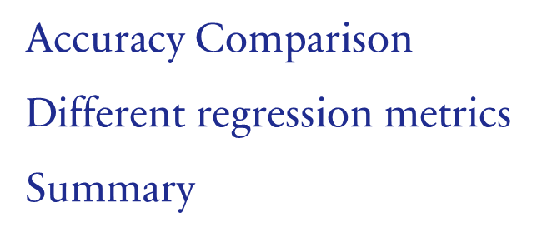
AGENDA
Introduction​
Primary goals
​Data Set
Histogram
Different Regression algorithms
UI

Slide 3
Introduction
The objective of this project is to build such a model using a dataset containing 50 companies and their corresponding values of R&D Spend, Administration Cost, Marketing Spend, and profit. The model will be trained using various machine learning algorithms, and the best-fit model will be selected based on its performance on various evaluation metrics.

Slide 4
PRIMARY GOALS
Model For Price Calculation

Slide 5
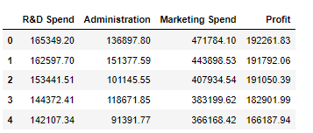
DataSET

Slide 6
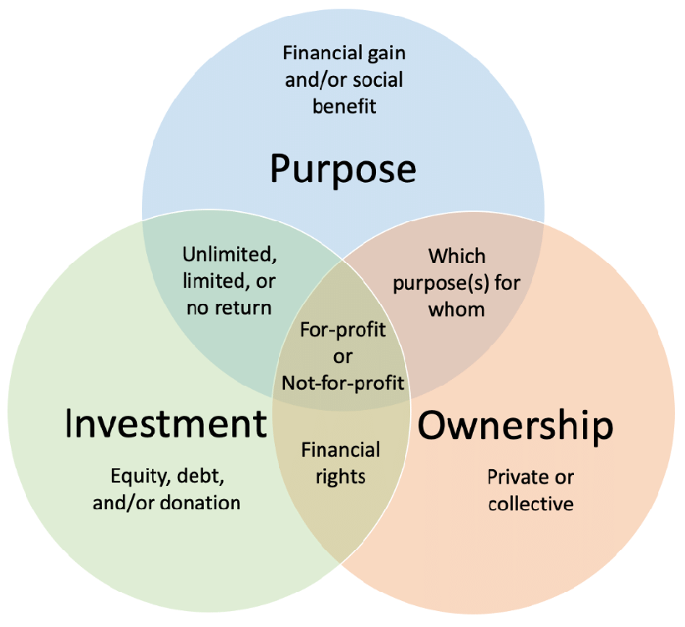
Profit Value Prediction

Slide 7
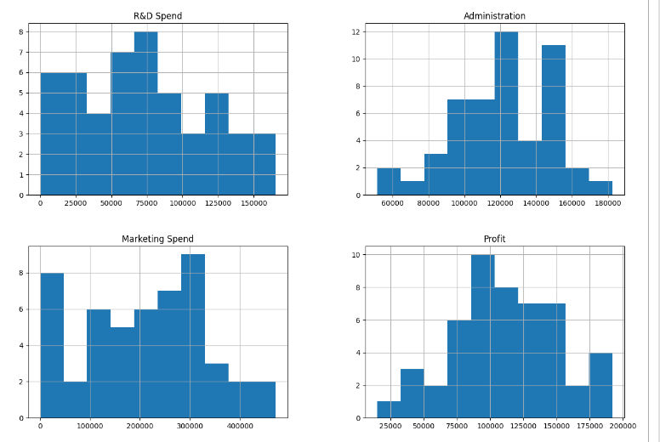
Histogram

Slide 8
Linear regression,Decision tree and random forest regression
Linear regression:
Logistic Regression is one of the most common classification algorithms.
Firstly we have divided the Dataset into X and Y, With the help of X , we will calculate Y(Price)
And then perform linear regression.
Decision Tree:
This classifier creates a decision tree based on which, it assigns the class values to each data point. Here, we can vary the maximum number of features to be considered while creating the model.
Random Forest:
This classifier takes the concept of decision trees to the next level. It creates a forest of trees where each tree is formed by a random selection of features from the total features.

Slide 9
Accuracy Comparison
Algorithms | Training Accuracy | Testing Accuracy
Linear Regression | 94% | 96%
Decision Tree | 100% | 81%
Random Forest | 98% | 91%
We can see that the random forest regression model outperformed the other two models in terms of all the metrics, with the lowest values of MSE, RMSE, and the highest value of R-squared. Therefore, the random forest regression model is the best model for this dataset.
The Above table shows the accuracy values for all five machine learning algorithms. It shows that Random Forest algorithm gives the one of the best accuracy with 98% training accuracy and 91% testing accuracy.

Slide 10
Metrics Regression
Regression Model | MAE | MSE | RMSE | R2
Linear Regression | 5713.00 | 4.32E+07 | 6574.27 | 0.9778
Decision Tree Regression | 14575.23 | 3.60E+08 | 18962.78 | 0.8149
Random Forest Regression | 10504.48 | 1.64E+08 | 12817.47 | 0.9154
We can see that the random forest regression model outperformed the other two models in terms of all the metrics, with the lowest values of MSE, RMSE, and the highest value of R-squared. Therefore, the random forest regression model is the best model for this dataset.

Slide 11
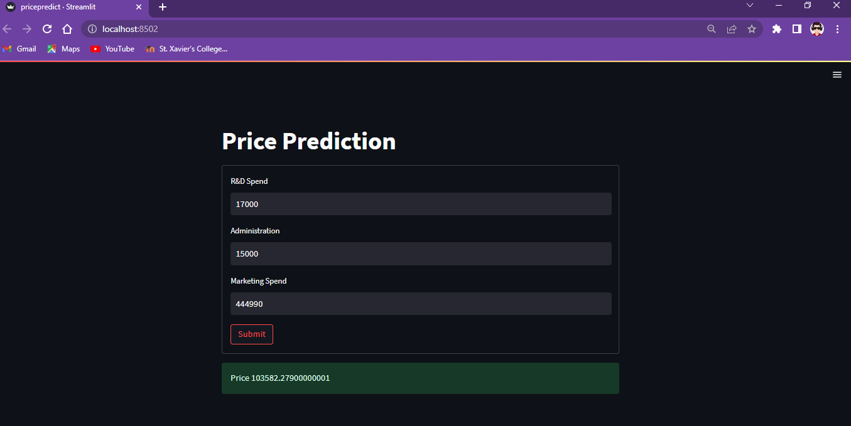
UI – USER INTERFACE

Slide 12
SUMMARY
Profit Value Prediction
Based on the analysis of the given dataset, we can conclude that there is a positive correlation between R&D spend, Administration cost, Marketing spend and the profit earned by the companies. Linear Regression, Decision Tree, and Random Forest were used to create models that can predict the profit of a company given the values of R&D spend, Administration cost, and Marketing spend.

Slide 13
THANK YOU
Gaurav Rawal
gauravrawal2001@gmail.com

